Slide 1


Slide 2
Government funding
Vote Health is the appropriation from Government (Treasury) for health services.
This funding is given to the Ministry of Health (policy) and Te Whatu Ora/Health NZ (operations) for the procurement and delivery of health services.
There are many ‘output expenses’ (or line items) in the appropriation, for which primary care (“Delivering Primary, Community, Public and Population Health Services”) was $8.67bn for FY2023/24 and is $9.09bn for FY2024/25; or 34% of ‘departmental expenditure’ (or 32% of the total annual appropriation) FY2024/25.
For the funding given, there is a series of ‘performance measures’ that assess the outcomes of investment.
https://www.treasury.govt.nz/publications/estimates/vote-health-health-sector-estimates-appropriations-2024-25from
Published 30 May 2024

Slide 3
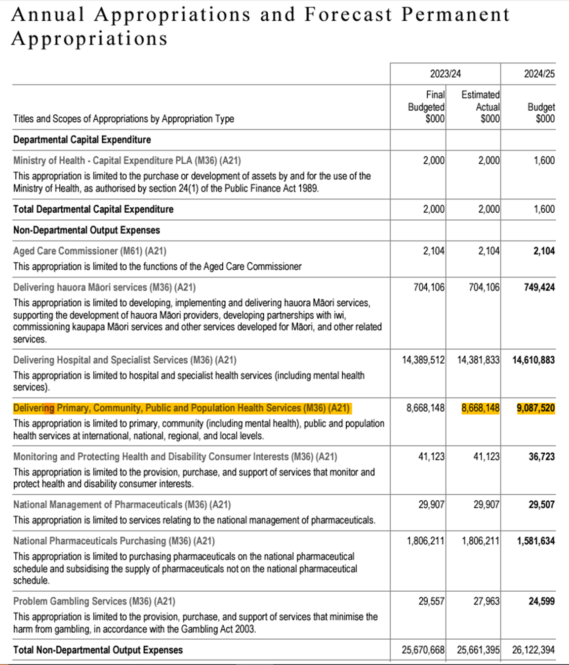
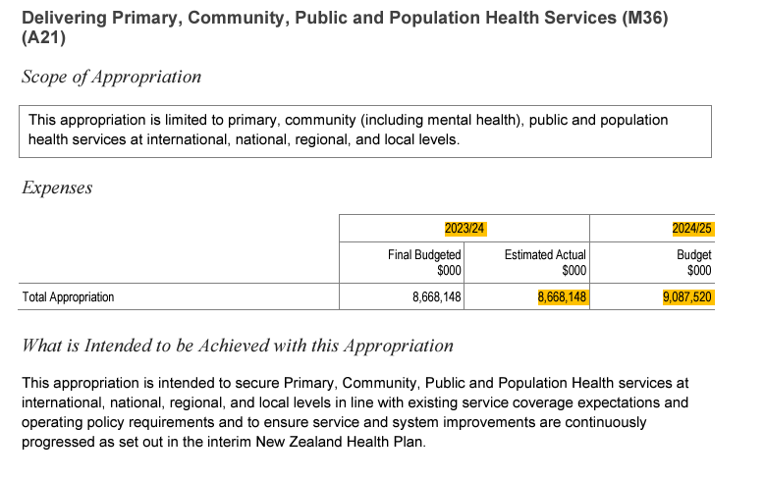
Vote Health – Budget 2023/24 + 2024/25
The increase/uplift across the appropriation is 4.84%

Slide 4
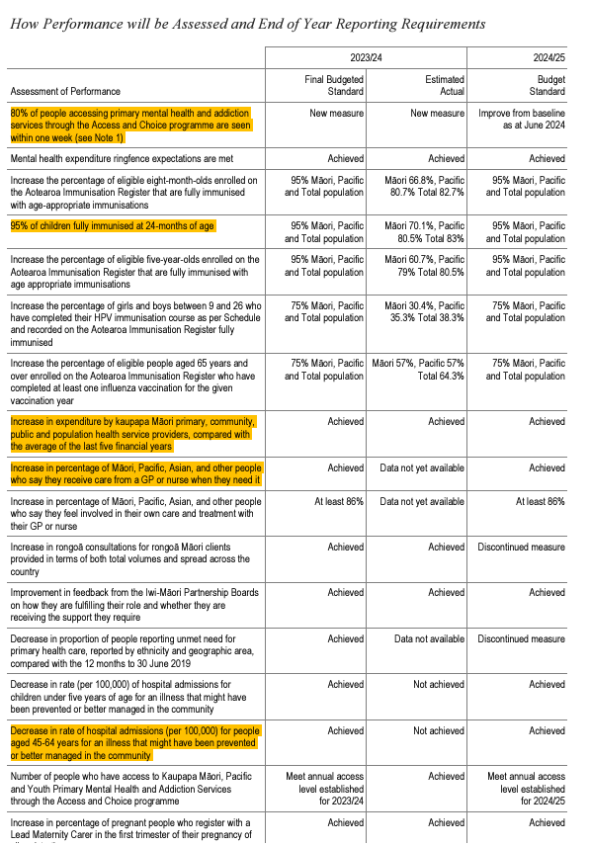
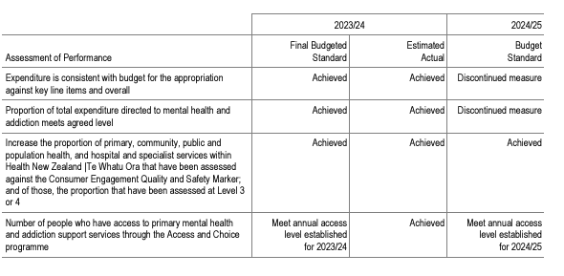
Vote Health – Performance measures
Performance measures focus on mental health and immunisations

Slide 5
How funding is distributed
New Zealand had 20 District Health Boards (DHBs) and were funded on a “population based funding formula (PBFF)” based on population, catchment, ethnicity, age, sex and deprivation.
Those Health Boards then allocated funding across their region with autonomy, which has led to significant variances in programme funding across the country.
One of Te Whatu Ora’s ‘problems to solve’ has been to seek consistency in funding and programme activity to ensure all New Zealanders have equitable access to health care.
Right now, Te Whatu Ora holds the funding for Primary Care and is working across the four regions to allocate and align primary and community initiatives.
For Southern, the funding allocation for 2023/24 was $118.3m or 1.4%.
Note: there's a catch! Whilst funding does increase year on year, what we are certain is that that it does not account for population growth and changing demographics. Furthermore, as Southern makes up 11% of the land area of New Zealand, it has a small number of people per square kilometer compared with the like of Christchurch or Auckland. This means that rurality, and the need for small and rural practices, which have the same rates, rent and electricity are not equally compensated as time passes on.

Slide 6
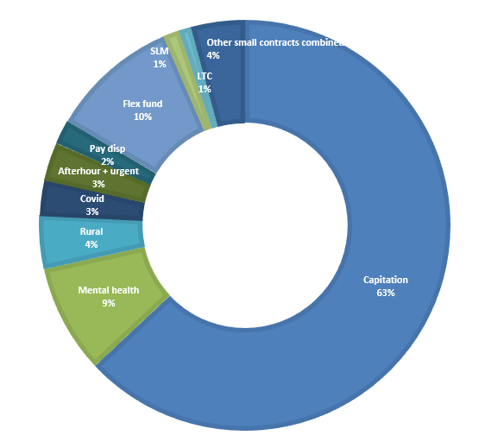
What funding did WellSouth receive?
For the year ending 30 June 2024 WellSouth was funded;
$74.5m Capitation (63% of total funding)
$10.1m Mental health programmes (8%)
$4.9m Rural funding (4%)
$3.3m Covid-19 funding (prior year $20.4m)
$3.6m After Hours + Urgent Care (3%)
$2.2m Primary Care nurse pay disparities (2%)
$1.2m Long term conditions
$1.7m Service Level Measures
$11.9m Flexible funding, which includes;
Management fee
System Level Measures/Health Targets
Health Promotion, Services to improve access and Care Plus
$5.0m smaller contracts such as; Pharmacy, Immunisations and Refugee integration
Note: Pay disparity and CPCT funding has not been contracted past 30 June 2025

Slide 7
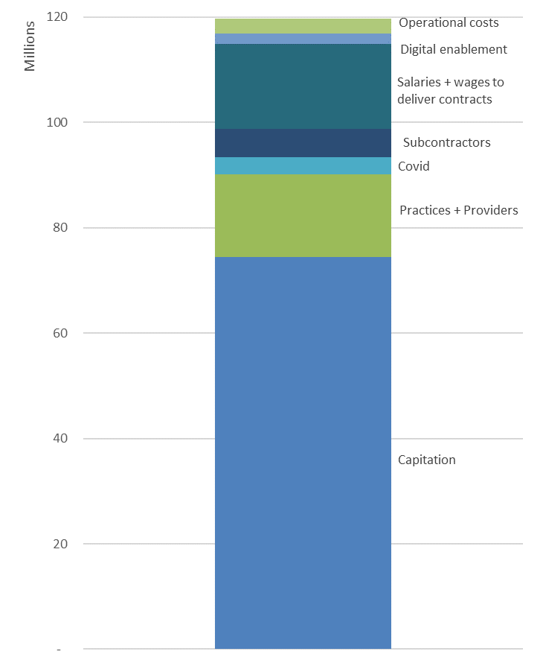
How did WellSouth spend it?
To deliver the contracts and programmes, funding is allocated;
$16.0m of Practice + Provider clinical claims
$5.3m to subcontract service delivery
$3.2m Covid related payments (prior year $20.4m)
$15.3m employee costs incl salaries, 75% of which is client facing or direct support to programme delivery such as pharmacists, mental health clinicians, primary care nurses, clinical advisors
$2.0m digital enablement, and
$3.8m on operational costs
As some of the Te Whatu Ora contracts are outdated and subsequently the contract value has not kept up with current operating cost, there are some contracts that require funding from WellSouth’s reserves in order to deliver what is required. ‘Top ups’ to contracts were;
Pharmacy $0.5m
Mental Health $0.1m
Palliative Care $0.3m
Unfunded clinical initiatives such as IV zoledronate, Māori and Pacific flu vaccinations 55 yrs plus

Slide 8
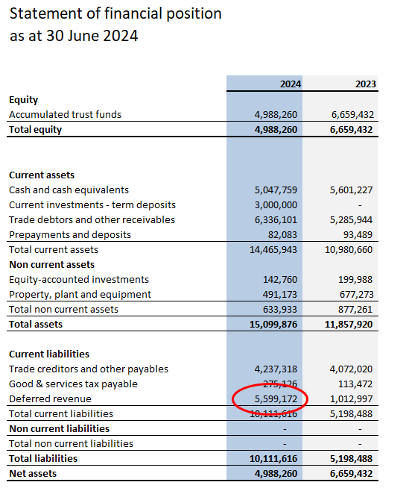
Money in the bank
Although WellSouth has reported a deficit, there is still a lot of money in the bank.
This is revenue received in advance from Te Whatu Ora to the value of $5.6m (an increase year on year of $4.6m).
This is not because WellSouth is not spending the contract income, rather Te Whatu Ora prefers to pay some contracts in advance. These included two large ‘one off’ programme funding;
$2.6m Comprehensive Primary Care Teams (ends 30 June 2025)
$1.5m Extended Primary Care (ends April 2025).

Slide 9
Deferred Revenue - Revenue in Advance
Specifically, the $5.6m revenue received in advance and funding unspent* recorded by contract;
*Note: some one asked what “unspent funding” funding was held. In this case 2022 and 2023 contract funds unspent/underspent are carried forward as ‘revenue in advance’

Slide 10
Long Term Conditions Programme
Careplus revenue funds the long term conditions programmes: Toitu Takata (TT) and Hapai Atu (HA).
This initiative was rolled out in early 2024.
Funding allocations were based on “practice’s enrolled patient demographic” i.e. the number of eligible, enrolled patients per practice as a proportion of the total number of eligible patients across the region.
Eligibility is found here: Toitu-Takata.pdf
One of the foundation principles was the ratio of CLIC:QuickCLIC (i.e. 3:1) programme allocation, which has been key to ensure the focus on support for a long term condition. In addition, as the programme has matured and utilisation continued to be examined there has been a chance to increase and review the places made available in each programme.
For example:
Toitu Takata budgeted 7,372 places, forecast used 5,155 and a draft budget of 7,450 for next financial year.
Hapi Atu budgeted 3,004 places, forecast used 2,688 and draft budget of 4,440 for next financial year.
For Practice A the eligible patient number was 892 (2024) and current forecast 847 (2025).
The below table shows the allocation of places per quarter against the practice average.
For Toitu Takata, the allocation is above average, and for Hapi Atu this is below.

Slide 11
Contract lifecycle
When Te Whatu Ora procures work either new or an extension of an existing contract, these have historically been long drawn out processes.
From the TWO Commissioning team that write the service specifications, the contract is drafted by the TWO Contracts team, processed through the TWO Finance team to raise a Purchase Order and then sent back to the TWO Contracts team before sent to WellSouth for signing.
Ensuring we keep both WellSouth, practices and community providers safe, the contract is expedited through internal checks and back out the door to TWO as quickly as practical.
In the past three years contracts have been reduced
to annual, and someone thought it was a good idea to
expire them on 30 June, end of the financial year, but
as seen last year, not taking into account PSSAP
negotiations which can take up to eight weeks before
Uplifts, CPI or other increases are determined, and
then there is a whole lot of extra work created for
everyone in the process, when things like back
pays etc. need to be calculated and invoiced - sigh
TWO Commissioning
TWO Contracts (Sector Ops)
TWO Finance team
TWO Contracts team
WellSouth
Notes:
Recent graduate nurse contract

Slide 12
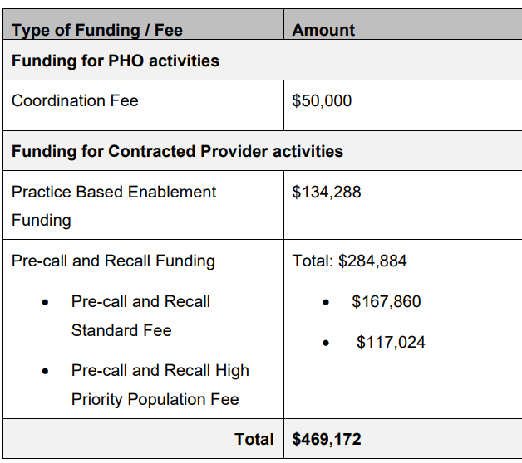
Contract specifications
WellSouth currently has 35 contracts ‘active’ with Te Whatu Ora.
Below is an example of different funding allocations relating to different contract delivery models;
1. WellSouth passes through 100% of funding to practices e.g. capitation, pay disparity
2. WellSouth delivers a contract through is employees e.g. Brief Intervention, FMHS
3. There is a mixed model of delivery and an overhead is specified e.g. CPCT, Access + Choice
Notes:
Recent graduate nurse contract

Slide 13
Looking forward – Forecast 2025
WellSouth reviews our financial performance periodically during the year and at the last forecast window the full year forecast revenue of $128m was analysed as follows.
All funds are focused and committed on delivery of services and patient outcomes.

