Slide 1

Understanding Development Needs...

Slide 2
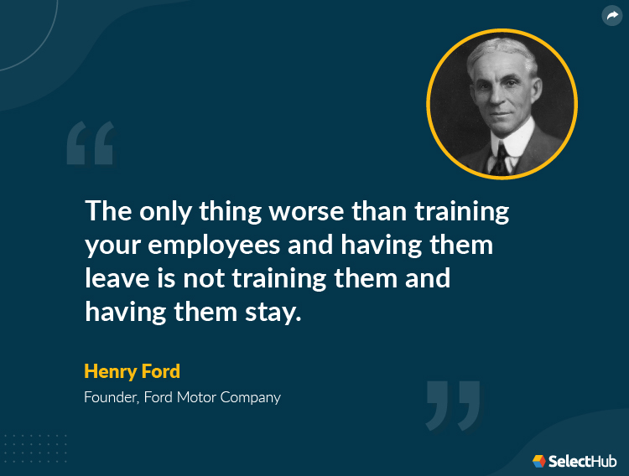

Slide 3
Why It Matters
Admin teams are often the first point of contact — their role is critical.
Supporting their growth = better service, less burnout, stronger teams – and of course, better retention rate.
We want to tailor training that works — with your help.

Slide 4
What we’ve asked
What skills need building? (e.g., communication, systems, resilience?).

Slide 5
What you’ve said
You have shared with us the following themes:
Basic Administration/Reception
Customer Service
Human Behaviour / De-escalation
Communication
Quality Improvement
Understanding Public Health Systems
Cultural Training / Equity

Slide 6
We’re Asking You
Are there any additional skills which you like trainings for?
What formats work? (Flexible E-learning option, in-person, Blended, bite-sized).

Slide 7
Next Steps
Collect feedback (today and beyond).
Co-design flexible options.
Trial small-scale sessions.
Refine based on feedback.

