Slide 1

Practice Managers Forum Immunisation 7th May 2025
Te Whatu Ora Southern AIR – Deborah Kay-Corkin & Rhiannon Barker
WellSouth – Jillian Boniface

Slide 2
Collaborative Partnerships
Data and the Story
Southern Tracking
Medtech Update
Thalamus Dashboard comparison
Tips and Tricks
Updated Outreach Guidelines
Emerging roles of Maori and Pacific Immunisation providers
Tips and Tricks
Overseas catch ups. Calculator Jillian

Slide 3
Data and the Story
Reports - why
oh why
Data and the story
We know our experts are in the practice
The story comes from practice
AIR need to have your story to create the data
Communication, following the monthly report is critical for us to maintain credibility of the data and eliminate further pressure on your teams.
Notes:
First of all the AIR team love data and spreadsheets. Behind every spreadsheet is a story and this is where you come in.
Whanau are managing all sorts of issues, financial, illness, vaccine hesitancy, and the list goes on. If AIR know you are working with a whanau we can halt comms and remove from reports as long as we have dialogue. I cant stress enough that if we know the story we stop referring, and support your work.
Outreach referrals. We are very lucky to see our Maori and Pacific providers supporting vaccination. There are whanau who may respond to a Maori or Pacific provider if you are not getting any response or struggling to reach.
Patient choice.

Slide 4
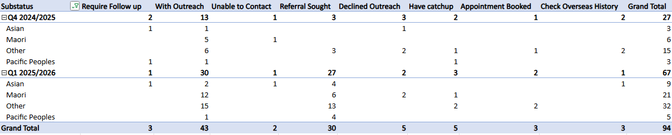
Southern Tracking
Current coverage – 87% for under 2 year olds
85% Pacific coverage
82% coverage for Māori, 3 children to vaccinate
We are at 85% for children turning 2 next quarter
Notes:
Kia ora etc
We have met and exceeded target for the current quarter, with our coverage sitting at 87% vaccinated. In the next quarter the target is being lifted to 87%, we are already at 85% so we are quietly optimistic that we will be able to achieve 87% again next quarter.
Having met target, we are not sitting back on our laurels, we have shifted our focus towards equity for Māori and Pacific Tamariki. We have met the target of 84% vaccinated for Pacific children and we only need to vaccinate 3 children to achieve the same for Māori.
As Deborah has already mentioned, it is the responses to the monthly overdue reports that drives our success and enables us to give dynamic reports to demonstrate how we are tracking each quarter. I have included an example here of the kinds of information we can share with the ministry of health to show how we work in Southern. With your assistance answering overdue reports we are able to track every child’s progress and have a real understanding of what is influencing our population’s immunisation journey. We really appreciate the time taken to answer these reports.

Slide 5
Medtech Update – April 2025
Working Together and Improving Immunisation Uptake
On 28 April Medtech made the below changes available in an Evolution Immunisation Update - April 2025. Please communicate to all practices using Medtech Evolution the importance of making this update and reading the release notes as soon as possible.
The update includes:
Updated the CIS to include PCV13 instead of PCV10
Updated the CIS to include MenB (3mth, 5mth, 12mth)
Transitioned patients onto CIS 2023
Updated recalls
Created alternative schedule for MenB (2mth, 4mth, 12mth)
Created catch-up schedules for when vaccines are given late
Created high risk schedules for HepB mother, HPV, MenB, PCV
Re-ordered the Immunisation Schedules list
Notes:
Aotearoa Immunisation Register Update – April 2025
Improvements to overdue reporting
Recent AIR updates have focused on PCV and MenB. These changes should make a significant difference to improve the quality of data sent in overdue reports to general practice and help prevent unnecessary follow-ups.
PMS vendor changes
Health New Zealand had been working with PMS vendors to ensure that PCV13 and MenB are included in the childhood immunisation schedule with the appropriate age-based indications.
On 28 April Medtech made the below changes available in an Evolution Immunisation Update - April 2025. Please communicate to all practices using Medtech Evolution the importance of making this update and reading the release notes as soon as possible. The update includes:
Updated the CIS to include PCV13 instead of PCV10
Updated the CIS to include MenB (3mth, 5mth, 12mth)
Transitioned patients onto CIS 2023
Updated recalls
Created alternative schedule for MenB (2mth, 4mth, 12mth)
Created catch-up schedules for when vaccines are given late
Created high risk schedules for HepB mother, HPV, MenB, PCV
Re-ordered the Immunisation Schedules list

Slide 6
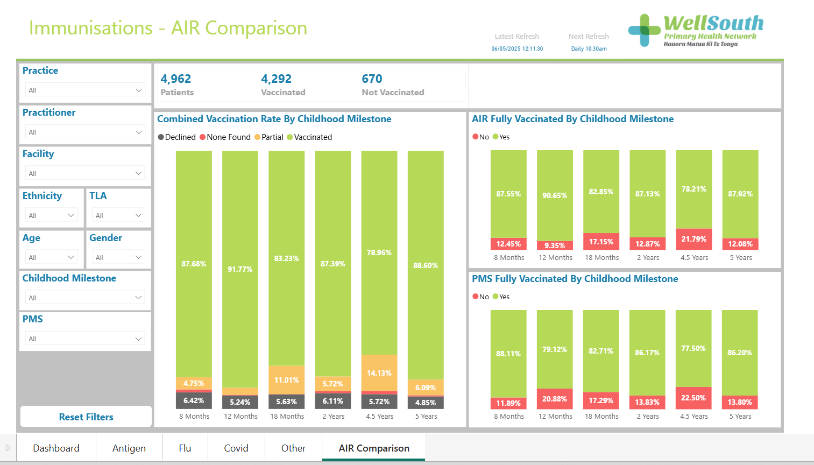
Thalamus Dashboard
Working Together and Improving Immunisation Uptake
Notes:
AIR send out a monthly Overdue list

Slide 7
Working Together and Improving Immunisation Uptake
Tips & Tricks
Precall / 3 Recall – phone/txt/email
‘Quick Fire’ Recalls (3)
Follow up with phone call
Utilise SLM Funding for additional Recall support
Offer next appointment at visit
Check when you last saw the child or their family
Check on HealthOne
Updated Outreach Referral Guidelines
More timely referral
Refer to Outreach via ERMs
Continue to Flag the Childs File
Notes:
Precall & 3 Recalls are the expected requirement for Immunisation process in Practices
You can do your usual routine text or email initially – but if the whanua haven’t responded by the 3rd attempt it is wise to attempt a phone call to check what is happening in their lives; especially if the previous imms have been given on time
It is worth spending time at this stage trying to make contact
Funding has been made available via the SLM Imms Plan Funding
Attempting to make the next Imms Appt as they leave is helpful as it locks the appt in On Time and they get a reminder so they can change if it doesn’t suit
We have now updated the Outreach Referral Guidelines to tighten the Referral times for 12 & 15 mth imms

Slide 8
Other Imms on Schedule:
Working Together and Improving Immunisation Uptake
Flu & Covid
Use of Thalamus Dashboard for coverage / those still to be vaccinated
Esp Preschool children with Respiratory Hospitalisation
Māori & Pacific 55 – 64 years WellSouth Funded
If you want to offer Covid Vacc contact your Relationship Manger and/or Jillian
11 Year Boostrix & HPV
HPV for under 27 years.
Notes:
Offer HPV at the 11 year visit
The School Based Programme still deliver HPV in Year 8 (2 doses 6 months apart)
The 1st Dose can be given at the Practice; with the 2nd dose through the School Programme
Deborah Putting on my Cervical Screening hat here - Cervical Cancer is the only cancer we now have a chance to eliminate. We have the tools with HPV vaccination alongside the HPV self test. Boys initially were not offered the HPV vaccination until around 2015 and there is a cohort out there who are within the eligible age group that can access free HPV vaccination. I would encourage every opportunity to offer this vaccination. HPV cancers are found orally, anally, penile and cervical. The toolkit is available we need to use it. Aotearoa is not meeting the WHO targets and Australia is even achieving targets.

Slide 9
Emerging roles of Māori and Pacific Immunisation providers
Working Together and Improving Immunisation Uptake
Māori & Pacific Providers are a willing resource.
Supports and supplements Outreach Services
Māori are not getting vaccinated
Māori have high decline rates
Notes:
We are very lucky to see our Maori and Pacific providers supporting vaccination. There are whanau who may respond to a Maori or Pacific provider if you are not getting any response or struggling to reach.
Supplement and support Outreach Services
Supporting Practice to reach whanau who are not connecting with pr
Non – enrolled patients could be referred to a Maori or Pacific Provider.
English as a 2nd language. Patient choice.

Slide 10
WellSouth Catch Up Calculator
Immunisation Catch up Calculator
Immunisation Calculator
A Clinical Tool to manage Immunisation Catch Ups; particularly Overseas Records
Records do need to be manually Entered into PMS for transfer to AIR
Contact Jillian or Immunisation Coordinator for Training
Working with National AIR to progress to immersion directly into AIR

Slide 11
When to get in touch for support
Contact the AIR admin team on
0800 787 998 or AIR@southerndhb.govt.nz
if you need:
Data entry errors fixed
Help with running reports from Power BI
Help with recording immunisations
Contact AIR service desk on
0800 855 066 when you need:
Password resets
Accounts unlocked
Assistance with onboarding to AIR
Access to reporting tools

Slide 12

Question Time

