Slide 1

Notes:
I’m not going to speak for 2 hours about Portals and surprised that with the meeting invite saying this that anyone has turned up. I could actually get this presentation over in 27 minutes by showing you the amazing lecture by Tom Delbanco right up front but I need to put a NZ context and reality check to the presentation he gave about Open Notes in Paris back in 2014.
My hope is that after tonight you’ve heard enough to make your own minds up about portals and don’t have to come out to another presentation- then I’ve done my job. I’m not being paid by the NZ HCH, Health Hawke’s Bay or MedTech but have had interest in portals as soon as I heard about them and then the story got personal which I’ll explain.

Slide 2
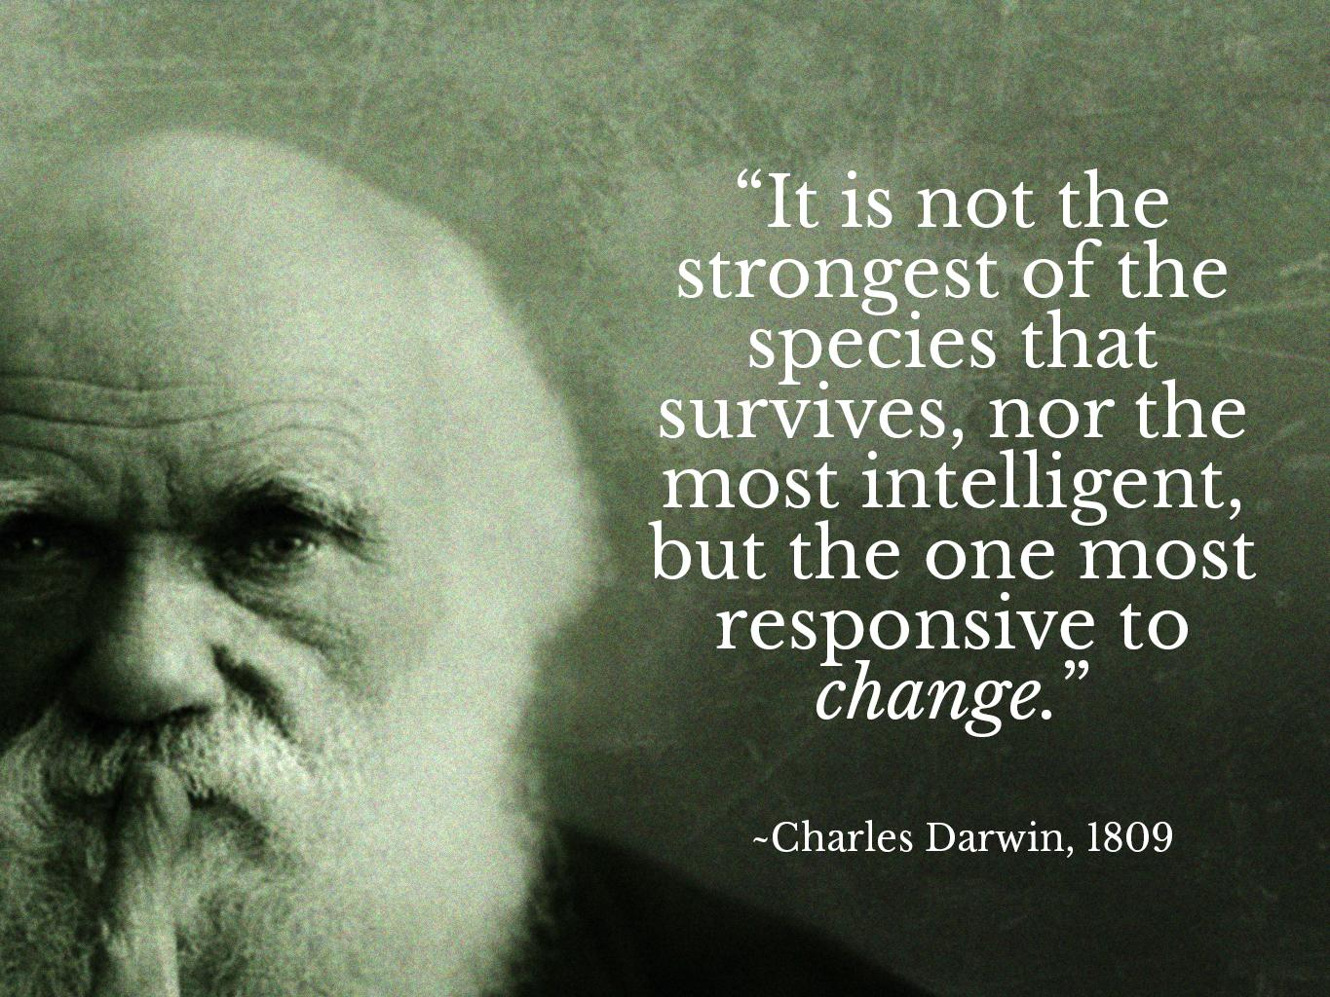
Notes:
386 Pentium with 16 MB Ram, tossed a coin. First Health Link electronic Dx summary. NHITB- e ambassador, early adverts

Slide 3
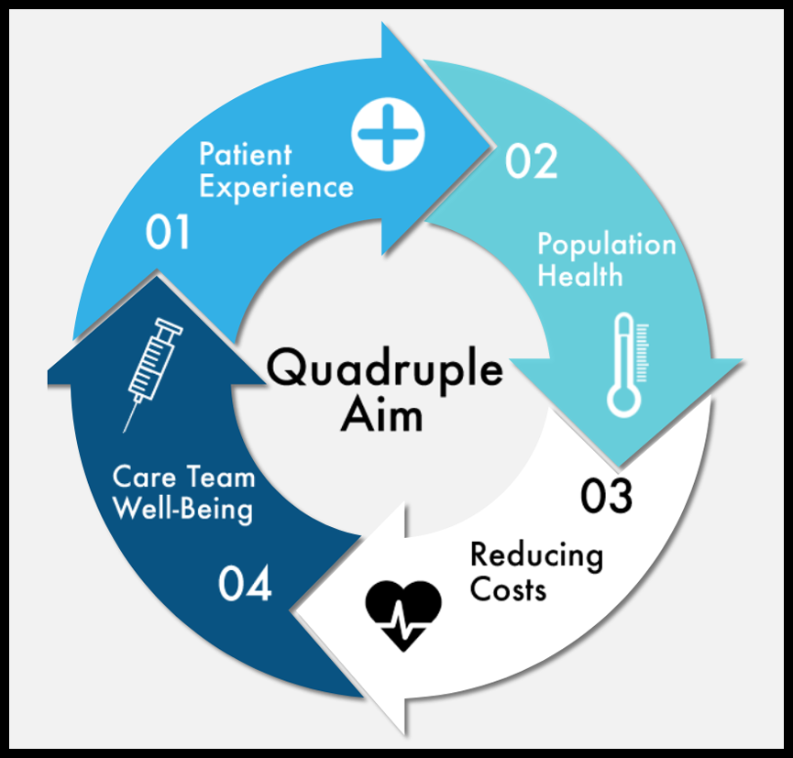
Notes:
Value patients time, value our time and improve both our experiences

Slide 4
One Patient’s Experience
No Portal so no access to results or ability to message my practice
Also no Shared Care plan or Advanced Care Plan
Sharpened my focus- what an e-Patient should be able to do
Silver lining is I’ve ended up with opportunities to look at things differently
Take home messages: get your own GP, have income replacement insurance and keep it updated

Slide 5
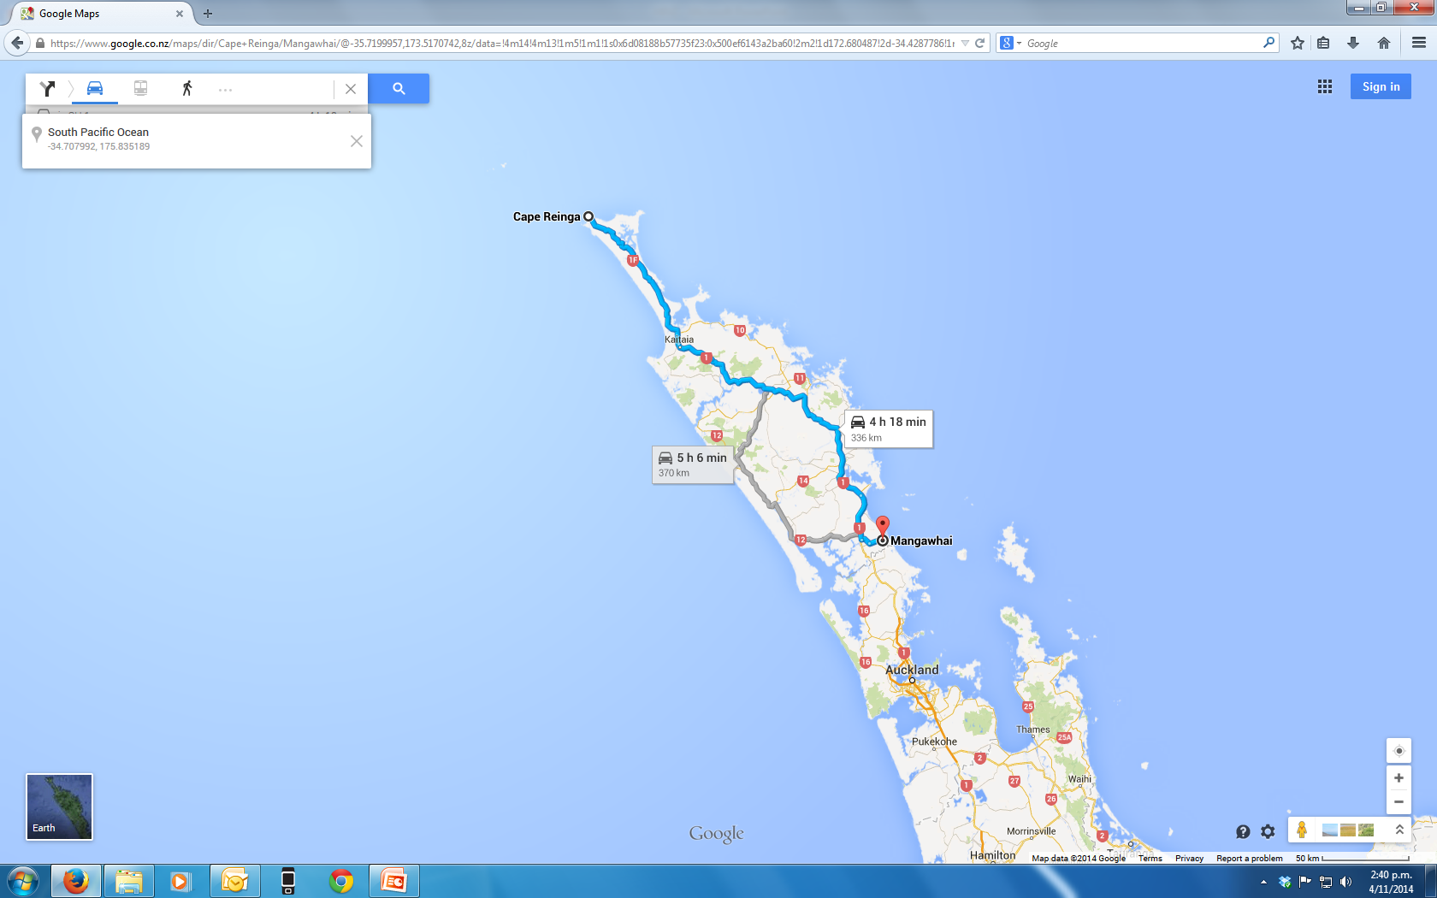

Slide 6
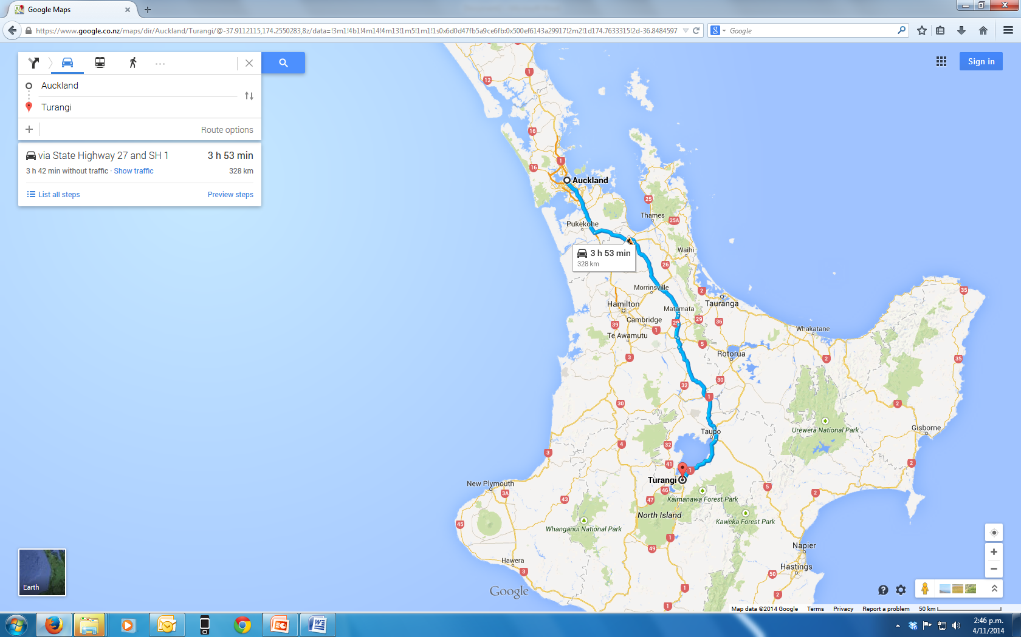

Slide 7
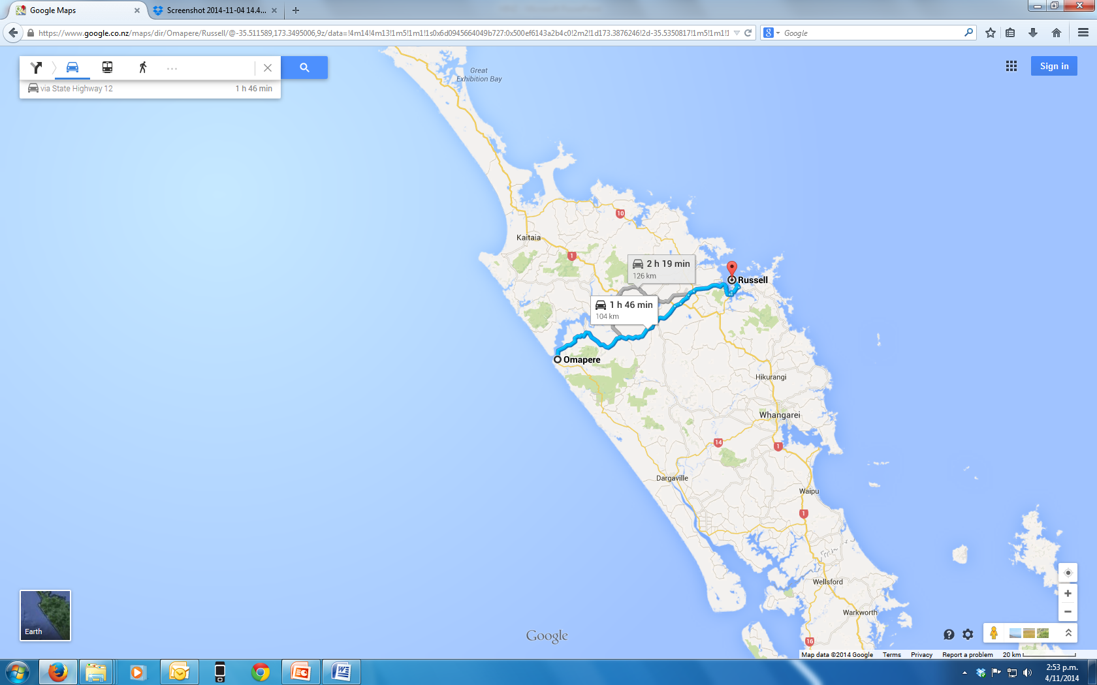

Slide 8
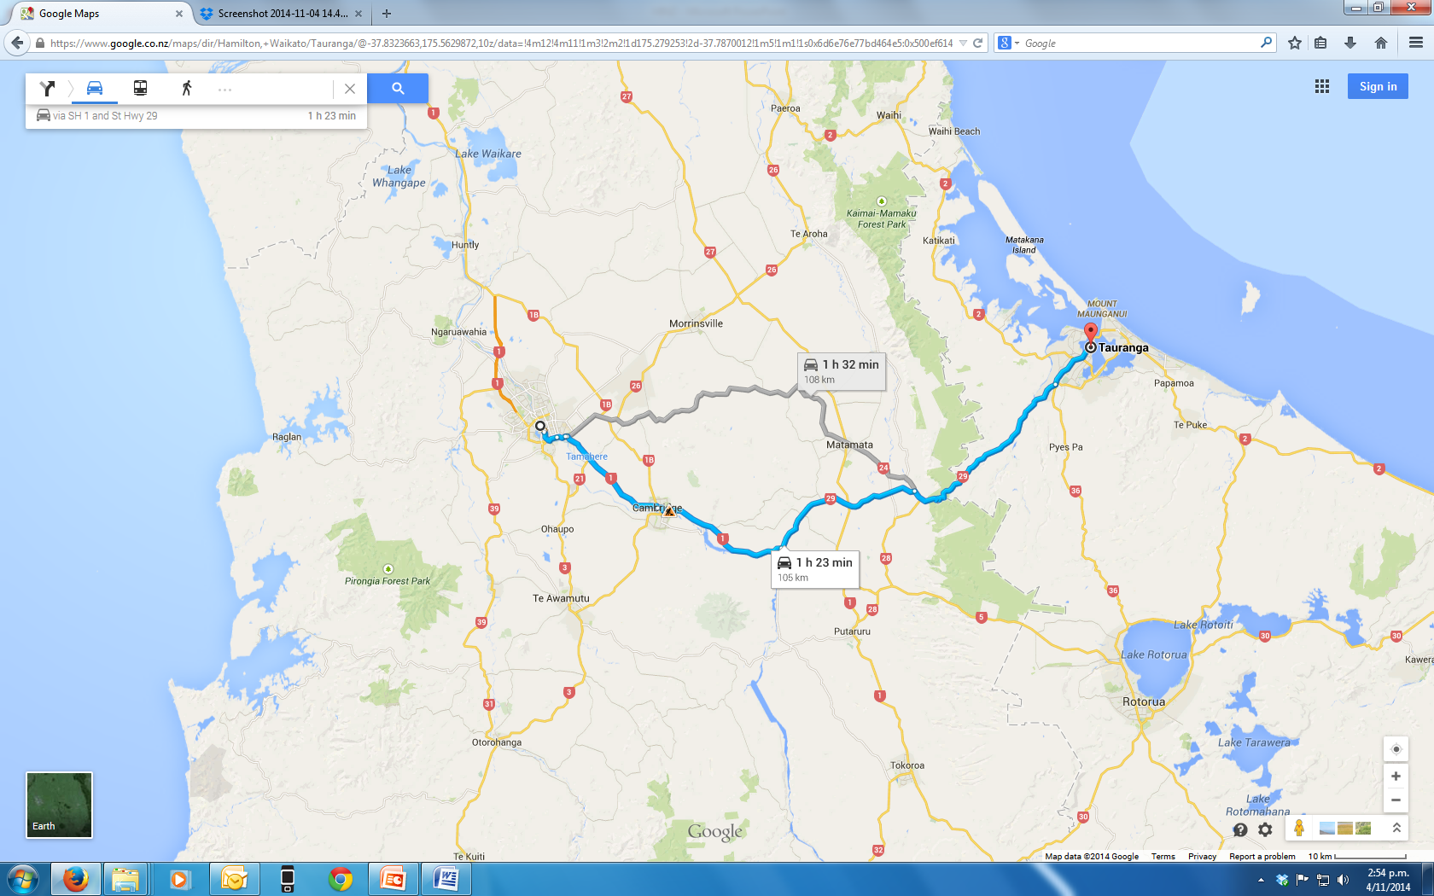

Slide 9
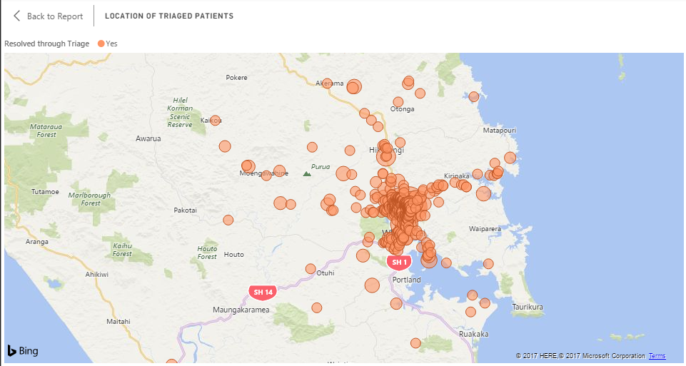

Slide 10

DO THE MATHS

Slide 11
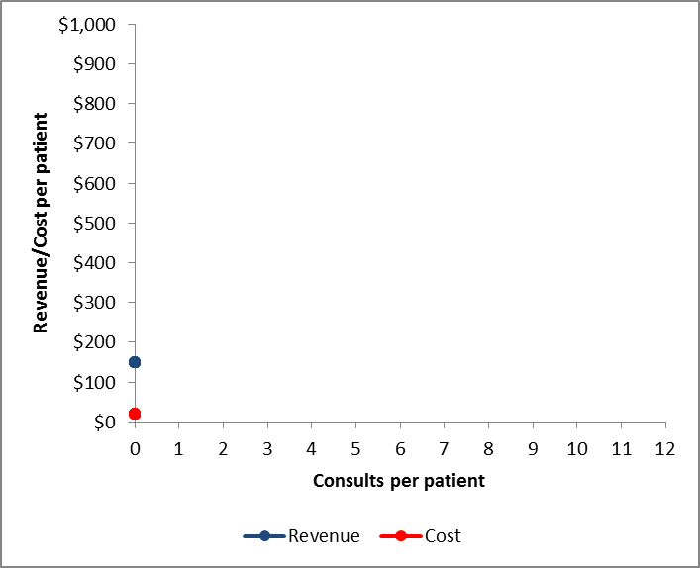
Profit margin

Slide 12
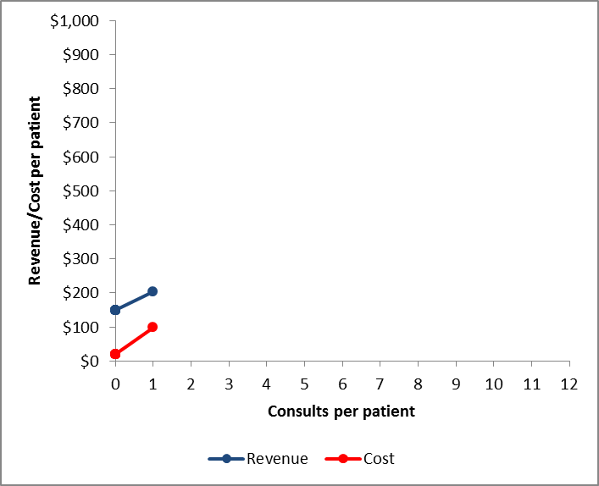

Slide 13
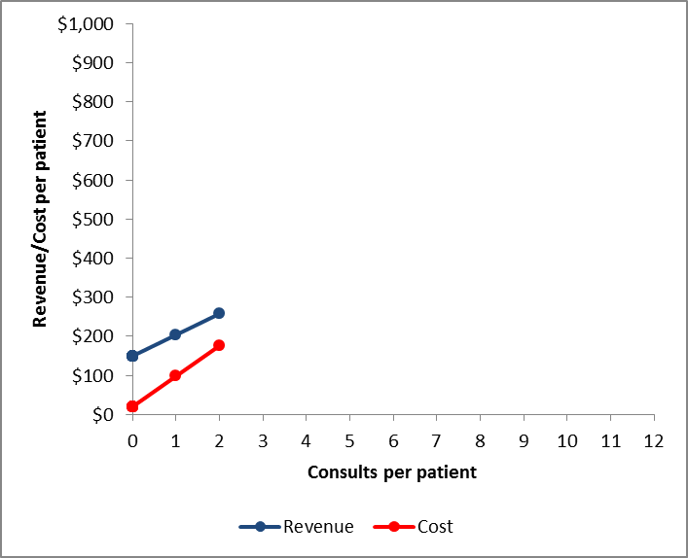

Slide 14
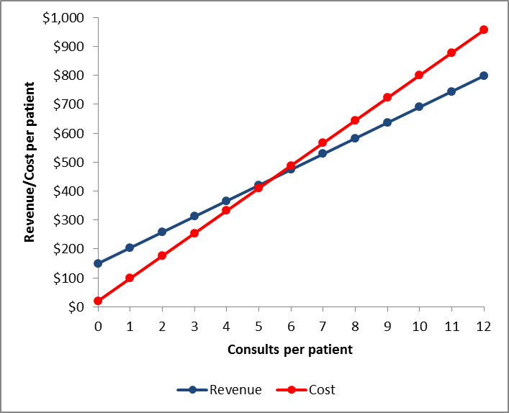
To be more sustainable:
reduce face to face consults
reduce cost/per consult

Slide 15
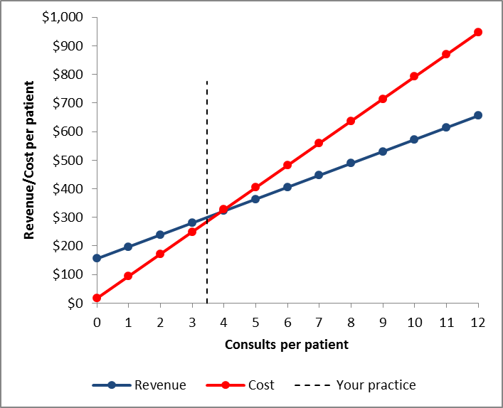
Bush Road

Slide 16
High consultation rates for the elderly

Slide 17
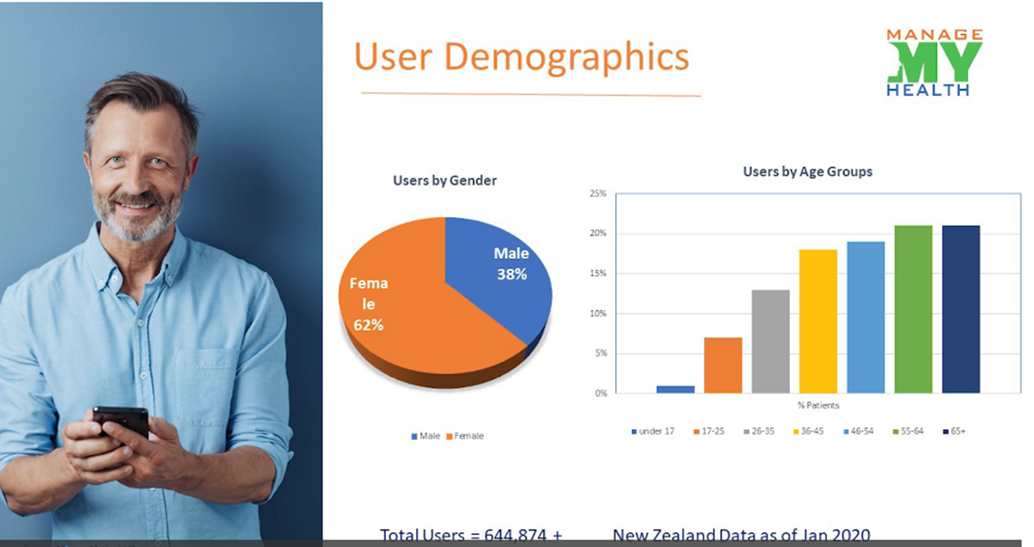

Slide 18
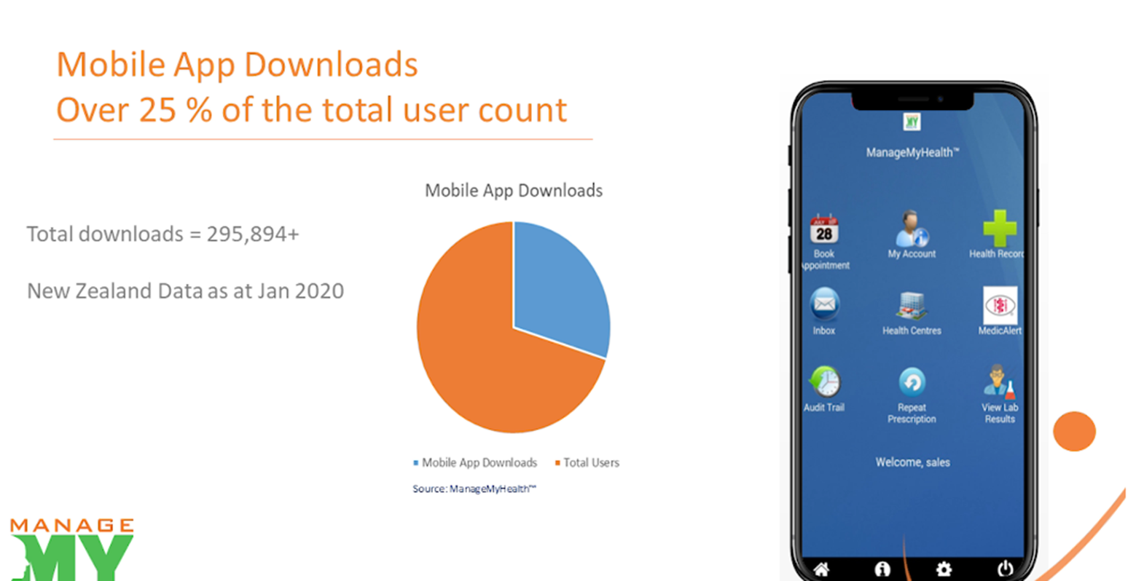

Slide 19
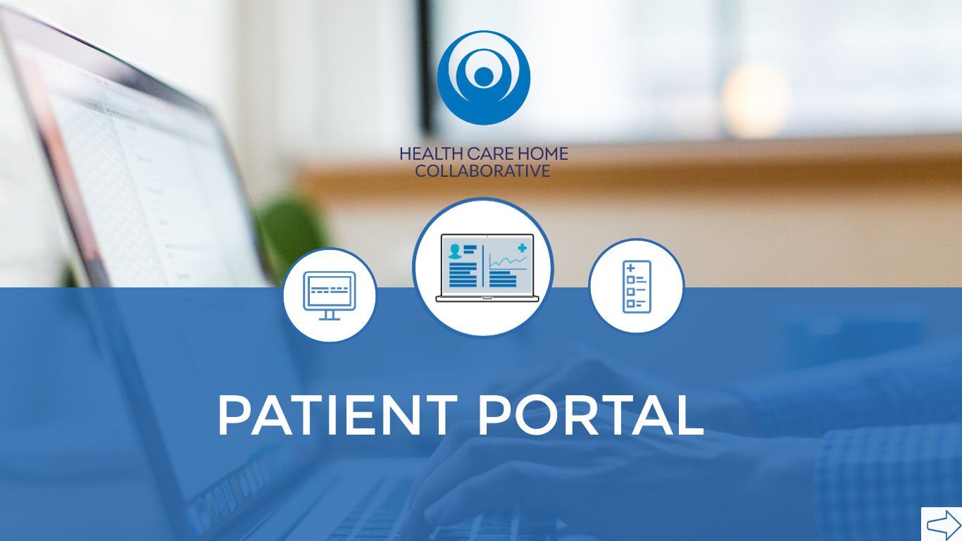

Slide 20
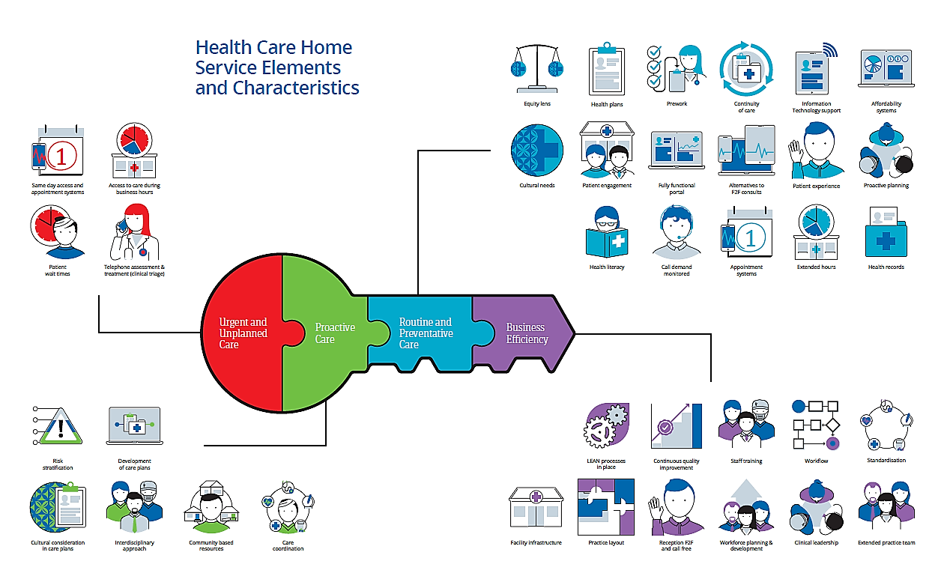

Notes:
The MOC has recently been updated and is a “work in progress” as ideas are challenged or improved. It’s not a tick box exercise. It’s a aspirational framework to make “gradual small improvements”. Having a National MOC is stopping replication of documentation, process and resources.

Slide 21
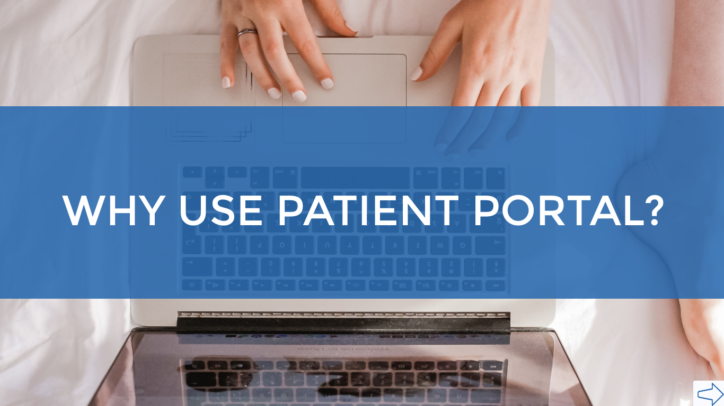

Slide 22
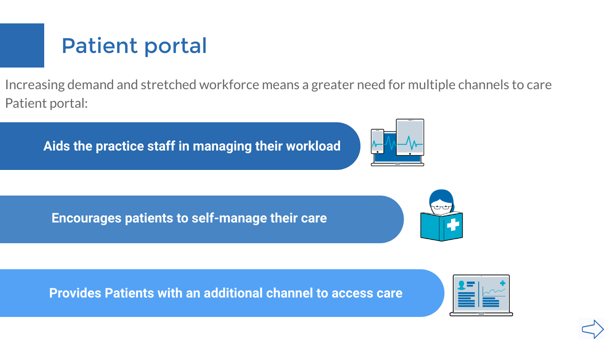

Slide 23
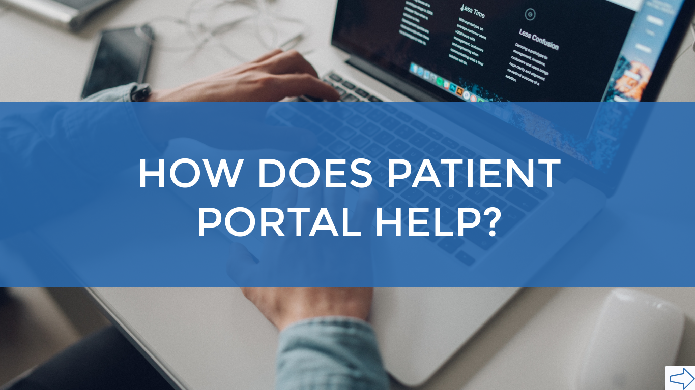

Slide 24
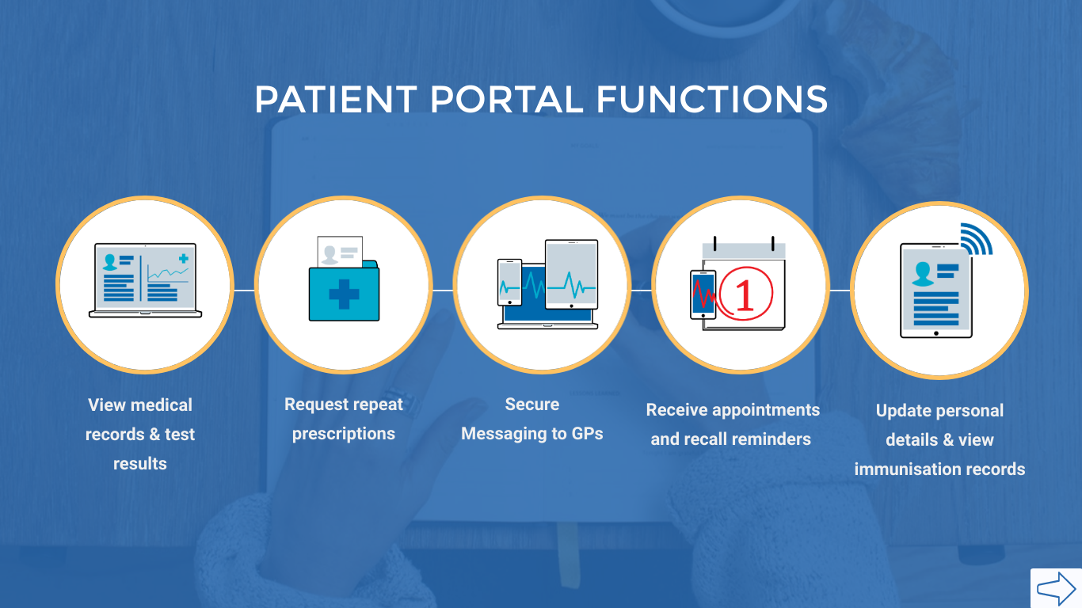

Slide 25
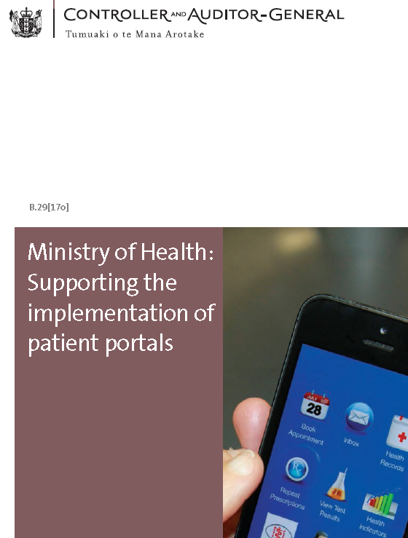
Notes:
2017

Slide 26
Notes:
All valid concerns

Slide 28
Pass the Patient Test
Take a room full of your patients
Explain how you currently deliver them “services”
Ask them if they think that’s reasonable and defensible
Likely then apologise and consider the patient view of things
Putting the Patient Test into action…

Slide 29
How are NZ Practices Doing?
NZ Practices with a Patient Portal 653/970= 67%
Average uptake per practice is 17.2% X 67%= 11% of NZ’ers with a portal
Open Notes 105/970 practices = 10.8% of practices
NZ’ers with Open Notes 10.8% X 11%= 1.2 %
Does our performance show we provide “care/service” for our patients?
How do we compare with banking, travel, accommodation?

Slide 30
Bush Road Medical Centre
Access Practice with 11,000 patients
Currently 2 FTE’s short with closed books
HCH for the last 4 years
Offered MMH portal since April 2015- before HCH
Northland has 26 of 38 practices with portal- all have Open Notes

Slide 31
Prof Tom Delbanco- Open Notes
Key Note in Paris 2014
In the 18 month after this speech Open Notes in USA grew to 4 Million
Now at 41 Million
Northland has 26 of 38 practices with portal- all have Open Notes

Slide 32
Open Notes After 7 Years: Patient Experiences With On-going Access to Their Clinicians’ Outpatient Visit Notes
J Med Internet Res 2019;21(5):e13876
Results: 136,815 patients with a 22% response rate. Of the 28,782 patient respondents, 63% female, 73% were aged 45 years or older. Among the 22,947 who reported reading 1 or more notes, 75% reported reading notes going back a year or longer, 50% reported reading at least 4 notes, and 37% shared a note with someone else.
Patients rated note reading as very important for helping take care of their health (73%), feeling in control of their care (70%), and remembering the plan of care (66%). Few were very confused (3.3%) or more worried (4.8%) after reading notes.
About a third reported being encouraged by their clinicians to read notes and a third told their clinicians they had read them. Less educated, non-white, older, and Hispanic patients, and individuals who usually did not speak English at home, were those most likely to report major benefits from note reading.
Nearly all respondents (98%) thought Web-based access to visit notes a good idea, and 62% rated this practice as very important for choosing a future provider.
Notes:
44 Million patients in the USA now have Open Notes. Not driven by HMOs but by clinicians and patients.

Slide 33
Our Experience
Started enrolling patients in April 2015- all records/Open notes to April 2014
4380 MMH patients (8607 eligible)= 51% of over 16yo’s
208 yet to get activated- consider Public WiFi
Year to date: 12,001 messages by patients, 14,244 by staff
MMH Scripts – 3040
MMH Appt Bookings- were 2482 p.a- now stopped due to Covid

Slide 34
Deeper Dive
Eligible patients enrolled per GP – range from 36% to 61%
Messages out per annum by GP- range from 1.22 to 4.11 (average 2.10)
Messages in per annum by GP- range 1.35 to 2.67 (average 1.93)
GP with most inbound messages NOT the GP with most outbound
SET UP RULES OF ENGAGEMENT.

Slide 35
Work to Do at Bush Road
Make sure all staff know how to enrol patients
Offer portal access to everyone in a more systematic way
Set up public WiFi in the practice and activate people on the spot
Tidy up current medication lists to make sure MMH scripts accurate
Accept that portals do alter workload/workflow and not all good

Slide 36
Coal Face Realities
High uptake of portals will increase doctor work: set aside virtual time
Out of Office functionality clunky
Set up “rules of engagement” to train patients about portal etiquette
Change the default wording to make sure you are messaging not consulting
Expect a subset of patients to be high users (not actually your worriers)
Avoid long threads- ring someone or get them in F-2-F.
Great to be able to correspond directly with your patients.

Slide 37
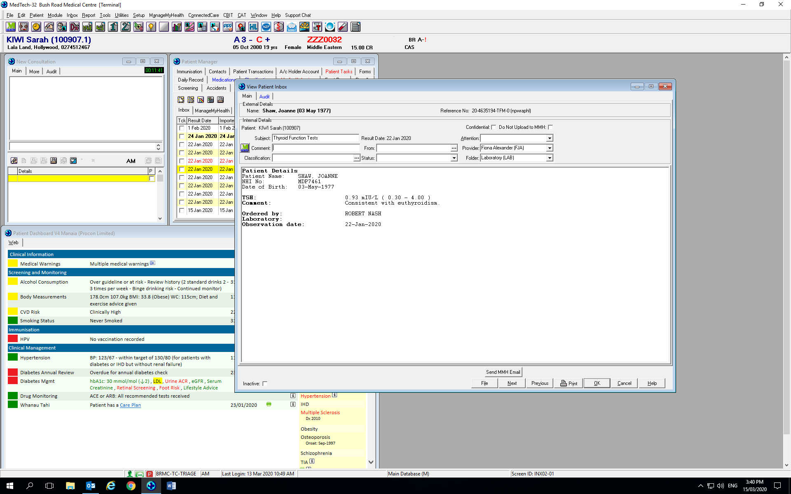

Slide 38
In the Pipeline
Simpler enrolment process
Give patients the ability to have proxy access- children/whanau members
NDHB going to sign up patients to send out Dx summaries/OPD letter to portal
Single sign on Portal- add 3rd Parties- FitBit, Shared Care, Labs, Rx’s etc.
Self management resources/Patient Decision Support

Slide 39
Thank you and Questions

