Slide 1
De Escalation Webinar
Notes:
Name who I am/ experience

Slide 2
Escalation

Slide 3
Plan
1. Fight / flight / freeze response : know yourself/ recognize in other people
2. Do something early : be objective
3.Debrief

Slide 4
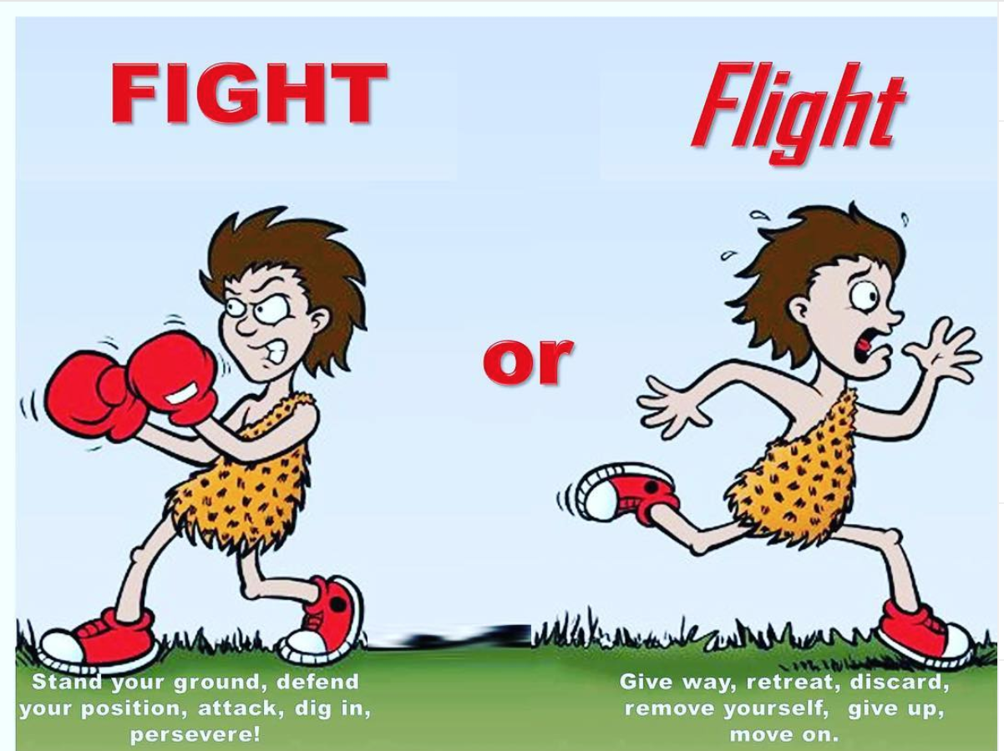
Why clients may be distressed
Often this is due to: fight/flight /Freeze response:
Keep in mind that whatever the person is going through, it may be the most important thing in their life at the moment.
Notes:
Loss of a sense of safety and control – unsafe, disempowered
Loss of something that was important
May be experiencing fear or frustration
Feeling threatened in some way
Be non- judgemental about this- what is important to you might not be the same as what is important to them.

Slide 5
Signs of someone escalating
Notes:
Be self aware – notice your own fight/flight freeze response – this is telling you something important – you are beginning to feel under threat.

Slide 6
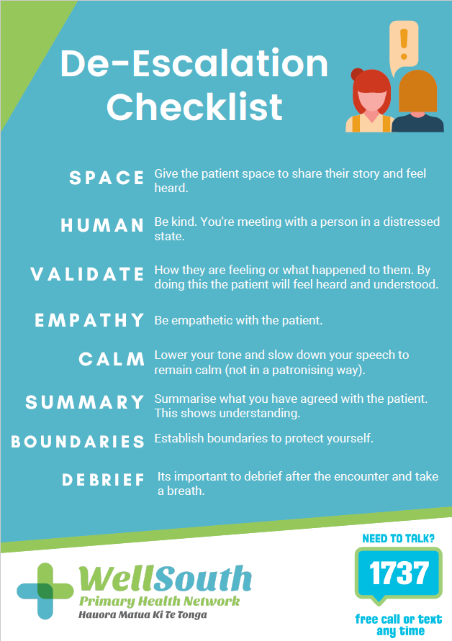
Poster/pdf available from workforce@wellsouth.org.nz

Slide 7
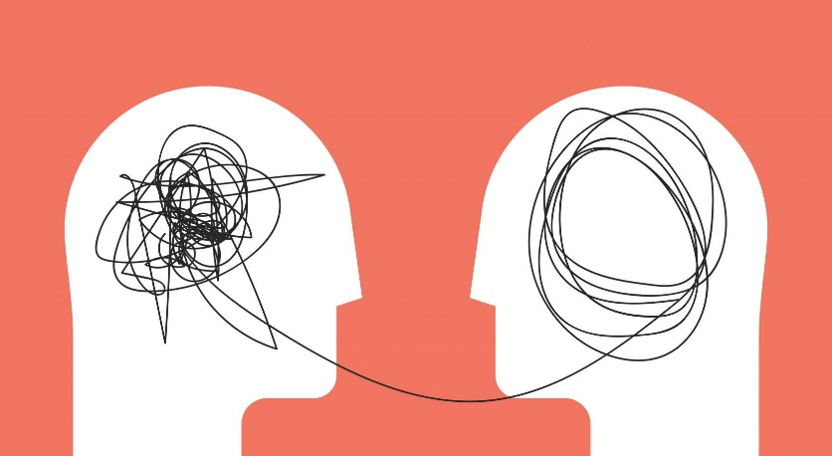
What you can do
SPACE
To share their story. The patient needs to feel heard.
It is important not to take it personally, the patient is distressed
If possible, stand a little further away from a person who’s escalating than normal. Allowing personal space tends to decrease a person’s anxiety and can help you prevent acting-out behaviour.
Notes:
Give the person space- to explain the problem , repeat what they have said to you , so they feel heard.
Give them physical space – if possible offer another room / space for them to talk in private : ensure you have an escape route.
Obviously if they are threatening, holding a weapon – get help immediately , call the police.

Slide 8
Be Human !
How can you treat this person with kindness , even if you don’t like their behaviour?
Use non-threatening non-verbals.
Remain calm, rational, and professional.
Notes:
The more a person loses control, the less they hear your words—and the more they react to your non-verbal communication. Be mindful of your gestures, facial expressions, movements, and tone of voice. Keeping your tone and body language neutral will go a long way toward defusing a situation.
For example stand side on to the person, keep your posture relaxed, don’t look at them directly, nod your head to show you understand. Get on the same level with the person.
While you can’t control the person’s behaviour, how you respond to their behaviour will have a direct effect on whether the situation escalates or defuses.
Match the patient's stance
If the patient is standing – stand with them
If the patient is sitting, then sit as well – match the level they are on
If possible, move the patient to a quiet area – this holds respect for the patient and it can tell the patient that you are taking them seriously and that you want to help. This could also distract the patient and reduce their anger.
Be mindful of where you place yourself in the room in case you need to leave quickly.

Slide 9
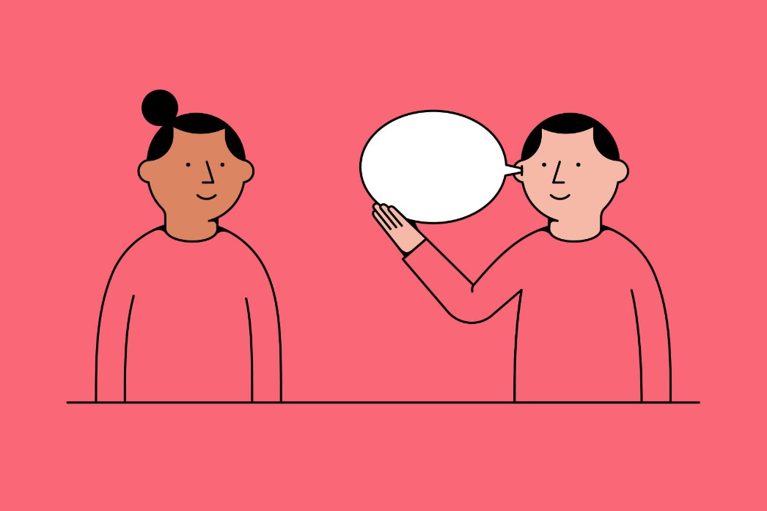
What you can do
VALIDATE THE PATIENT
On how they are feeling, or what happened to the patient. By doing this the patient will feel heard and understood.
“That sounds awful”
“I’m sorry you had that experience.
Let’s see how I can help.”
“I can hear you are really upset now”
Notes:
Validate their experience
Avoid debates
Be flexible where you can , be clear when there is a rule.

Slide 10
What you can do
EMPATHY
Facts are important, but how a person feels is the heart of the matter. Yet some people have trouble identifying how they feel about what’s happening to them.
Watch and listen carefully for the person’s real message. Ask yourself what are they feeling ? And label it for them.
Reflect back the feeling: ‘ you are really angry about that’ or ‘ sounds frustrating for you’

Slide 11
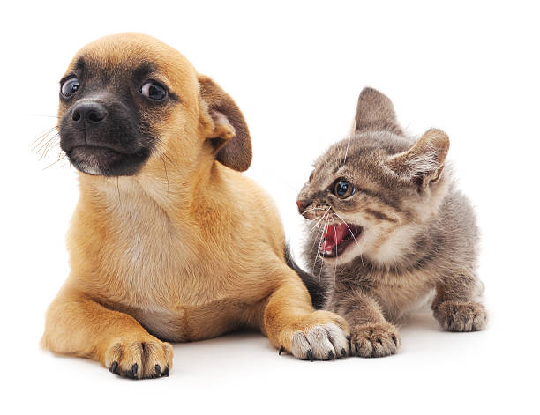
What you can do
Calm
Avoid over-reacting
Stay calm – it is hard to stay being angry with someone who is calm
Ignore challenging questions.
Answering challenging questions often results in a power struggle. When a person challenges your authority, redirect their attention to the issue at hand.
Ignore the challenge, but not the person. Bring their focus back to how you can work together to solve the problem
Notes:
Avoid debates
Positive thoughts like “I can handle this” and “I know what to do” will help you maintain your own rationality and calm the person down

Slide 12
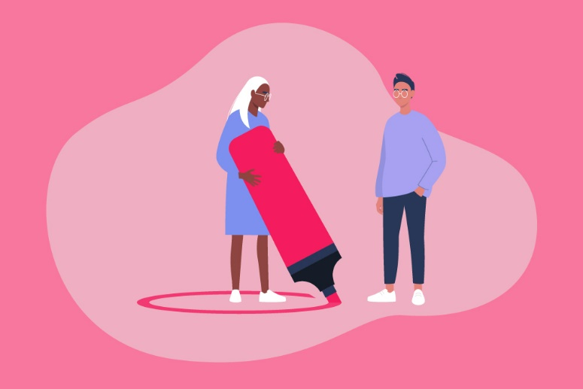
What you can do
BOUNDARIES
Set limits.
If a person’s behaviour is belligerent, defensive, or disruptive, give them clear, simple, and enforceable limits.
Offer concise and respectful choices and consequences.
A person who’s upset may not be able to focus on everything you say. Be clear, speak simply, and offer the positive choice first.
Notes:
I want to help you, please stop shouting then I can understand the problem. Do not get into a debate . Do not tolerate threats. Intervene early.
If you know the patient’s name then use their name e.g Collin or Mrs Brown. This brings the attention back to the patient and it can shift the rant. If the patient is yelling, then say in a calm but firm voice
“Collin. I would like to hear what have to say. I can see you are distressed, but I can’t hear you while you are yelling ”
Pick a short phrase a stick with it. For example ‘ I want to help ‘ If they are threatening ‘ I am not having that conversation- but I am here to help…what is the problem ?’

Slide 13
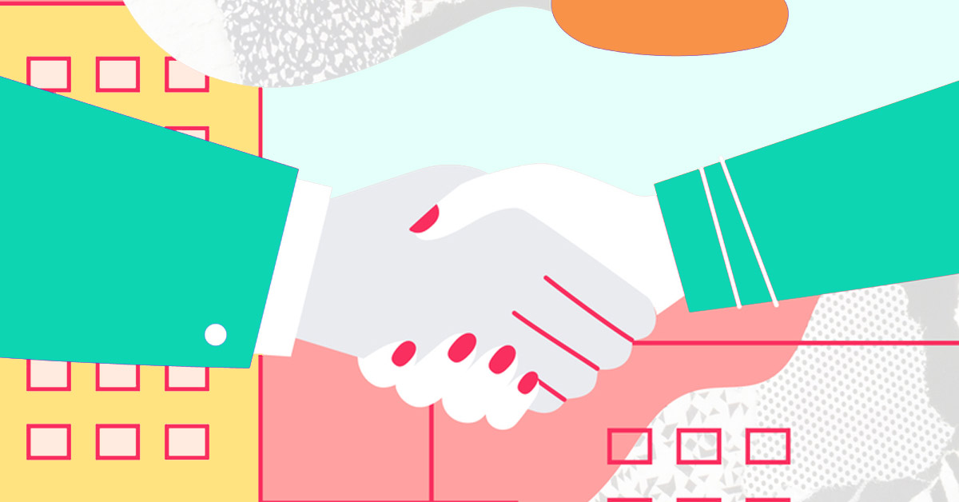
What you can do
SUMMARISE
Summarise what you have heard.
Do not rush the person into a decision- this can escalate things again
It is ok to be silent – it gives them time to gather themselves
If you have come up with a plan /agreement repeat it or write it down.
You could apologise or agree with the patients grievance if appropriate.

Slide 14
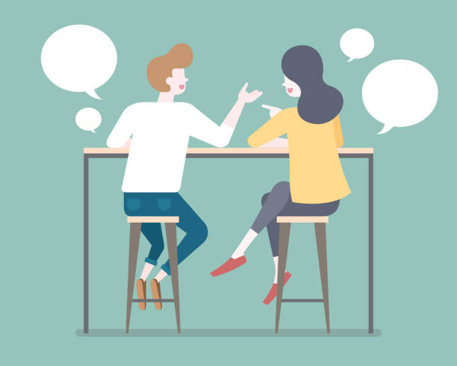
What you can do
DEBRIEF
Yourself
Others
.
Notes:
These kind of encounters get our fight/ flight/ freeze response going .
As soon as possible let someone else know what happened- and how you feel about it
-let you line manager know
If it was loud / disruptive debrief others- you may feel ok , but it might have been frightening for other staff : your role modelling how to manage is very helpful to other staff
- use EAP services or someone else you trust to get feedback on how you handled it – this will increase your confidence for the next time.
Discuss strategies for your particular situation with co- workers.
have a plan for emergencies – make sure you know what the policy is for your practice.

Slide 15
Scenario 1
Female patient in their 30’s
Comes into the practice – shouting demanding to see a doctor .- does not have an appointment
Quickly starts swearing , raises voice, says loudly no-one cares in this practice.
Their script has not been sent to the pharmacy when they expected it to be.
In small groups – have discussion –
How are you likely to react – fight/ flight or freeze?
How could you give the person space?
Set boundaries?
Validate?
Show empathy ?

Slide 16
Scenario 2 – Phone contact
A patient has called you and they’re angry about not being able to get an appointment until next week. They start to threaten to post on face book what bad service they get at this practice. They are being loud , demanding and it is difficult to get a word in ..
In small groups
: how can you set boundaries ? – what words would you use?
: What strategies can you use to you stay calm yourself ?
: how can you bring their focus back to solving the problem
: at what point would you terminate the call?
: who would you debrief with? What would you say ?
Notes:
After the encounter. It is important for you to take a breath after these encounters. This can be hard to do, especially when other patients are waiting, but it is still important to do this.
Debrief with someone, if this isn’t available get a cuppa / have a break so that you can regroup before helping the next patient.

Slide 17
9 De-escalation Skills Video
https://youtu.be/MOeuoNP-fyQ this clip is 9 de-escalation skills.
They refer to Patrons where we would talk about Patients.

