Slide 1
Breast Cancer Care
- Local data
- Examination technique
- Contraception, HRT and Breast cancer
- Managing side effects of Endocrine therapy
- Referral process updates
Alice Febery

Slide 2
Local Data
Approximately 120 cases / yr operative (additional 15-20 Endocrine management or palliation)
12% Maori
85% invasive breast cancer cf to 15% insitu
45% BreastScreen detected
Average size invasive component 21.5mm
Grade 1 25%, 2 44%, 3 27%
Multifocal 6%

Slide 3
Triage data - 2021
328 referred with breast lump Jan – Dec 2021
  26% High Suspicion, 25% Urgent, 49% semi-urgent, 26% routine
  Median age 42
7% of high suspicion referral resulted in cancer diagnosis
High Suspicion referrals downgraded to Urgent in 36%
49% of HS referrals had no clinical or Radiological finding
GP Sensitivity 62%, Specificity 80%
Notes:
One stop shop approach and triple assessment had underpinned breast care models for decades. Difficult to deliver in our current climate
Good at referring in cancers as high suspicion….but also have referred in mostly non cancers
Low sens and spec….but this is similar to international data – UK study 10%
How do we do better for our patients ….

Slide 4
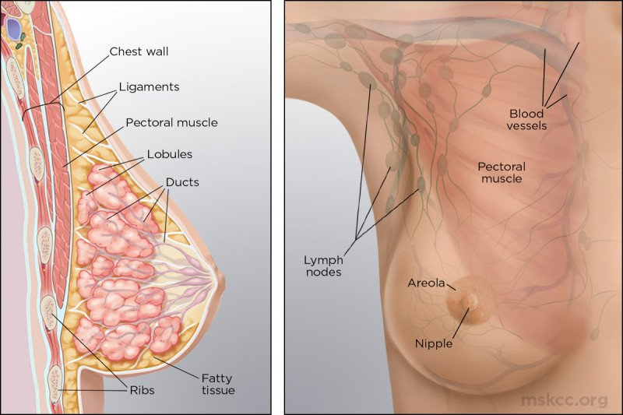
Clinical Breast Examination - The evidence
Sensitivity 30-60% … cf to Mammography 80-97%
Lower sensitivity in dense breasts, <45, & >80
  Size <2cm
  Location NOT associated with sensitivity
  Use of combined estrogen medication – incr sensitivity

Slide 5
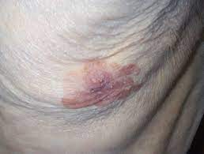

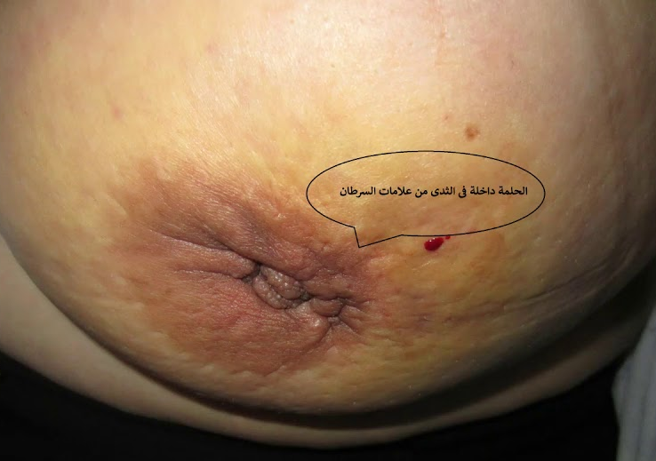
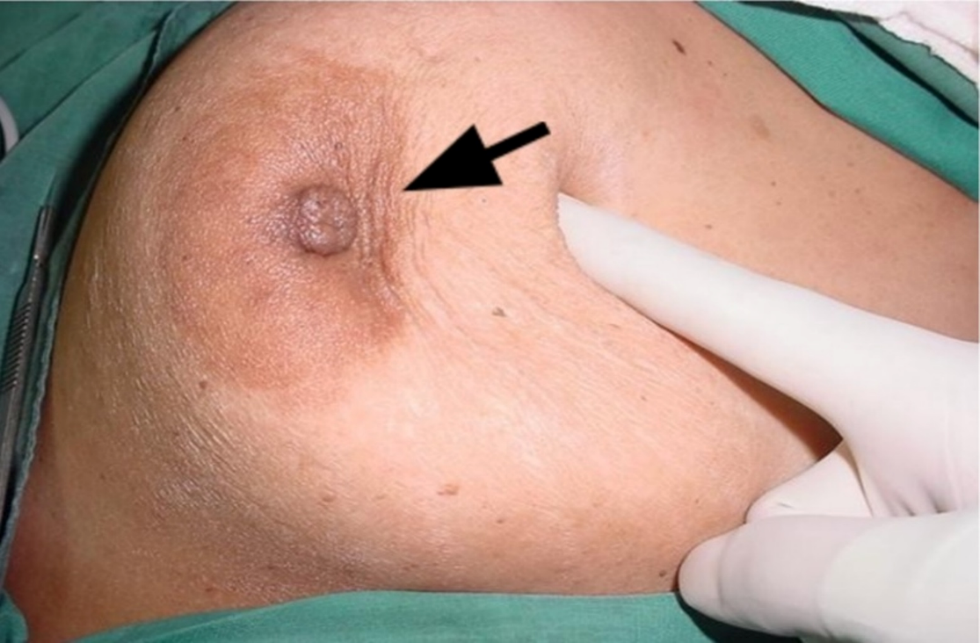
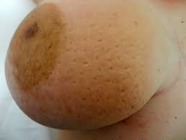
How to examine
Inspect – raise arms
  Contour
  Skin dimpling
  Nipple areolar
  Tethering
  Peau’d orange

Slide 6

Palpation
The axilla
  Sitting
  Supine
  Don’t forget the clavicular fossa
The breast
  3 mins
  Finger pads
  2 hands
  Circular motion
  Systematic

Slide 7
Risks
Obesity BM >30, RR 1.33
Smoking RR 1.2 (ever smoked)
Alcohol RR 1.04 – 1.2 – 1.6ly
OCP RR 1.2
HRT RR 1. 38
Breast density 1.2-1.5(C) up to 2.1-2.3 (D)
Proliferative breast disease RR 1.76
Others…height, Caucasian, Nulliparous, Chest radiation for lymphoma
Notes:
I am going to focus on 2 exogenous hormone risks, focus on these because we prescribe them….but in the big picture there are other more significant unmanaged risks
Obesity in post menopausal ER pos women mainly, also higher rates of TNBC
Smoking – early / perimenarche is most significant period
Alcohol… light drinkers have a slightly increased (1.04-fold higher) risk of breast cancer, compared with nondrinkers. The risk increase is greater in moderate drinkers (1.23-fold higher) and heavy drinkers (1.6-fold higher)

Slide 8
Contraception & breast cancer
Average risk patient / normal population
  >5 yrs & risk persists for >5 yrs
  1.09 RR at 1 yr, 1.2 RR at 2 yrs, 1. 38 RR at 5yrs
  Risks remain for low dose, combined, and other modes of delivery
High risk patient
  Risks are potentially cumulative, complex interaction of genetics, lifestyle, endogenous hormones and exogenous hormones
  BRCA1/2 with OCP, slight reduction in Ovarian ca, non statistically significant increase in breast cancer
  High risk family hx - inconclusive
Post cancer diagnosis / surveillance stage
  Avoid hormonal contraception
  Recommend barrier contraception, sterilisation, non hormonal IUD
Notes:
Survivorship issues… higher rates of EOCP & abortions, ovarian suppression due to chemotherapy has a variable course – fertility may resume 2 yrs post
Tamox – teratogenic
Goserelin – hypogonadism not guareenteed infertility so rec barrier/IUD contraception

Slide 9
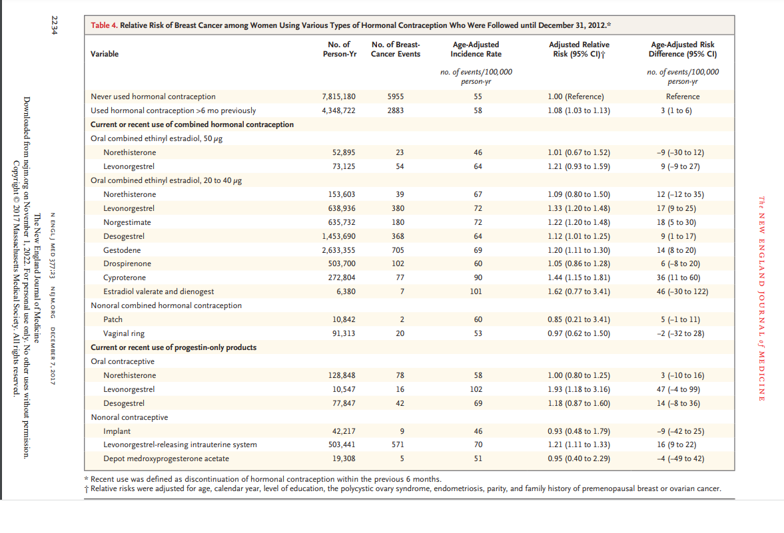

Slide 10
HRT / MHT
NB – NOT in reference to premature ovarian suppression/cessation
Average risk / general population
  Informed consent
  Estrogen only 1.14, Combined RR 1.7
  Generalised menopausal symptoms then prefer Estrogen only (where suitable), some progesterones safer (dydrogesterone)
  Vaginal estrogens = no increase in risk
  Takes 1 yr for risk to increase
  Reduces to baseline 2-10 yrs after cessation
Notes:
Duration-dependent increase in the risk of breast cancer diagnosis with both unopposed estrogen and combined MHT.
The risk is higher with continuous combined MHT regimens compared to cyclical.
The risk of breast cancer remains elevated more than 10 years after discontinuing MHT.
No estrogen dosage effect on the risk of breast cancer with MHT.
Vaginal estrogen exposure did not increase the risk of breast cancer diagnosis.
Only a small number of women on micronized progesterone were included. Therefore, conclusions regarding its impact on the risk of breast cancer diagnosis could not be determined from this meta-analysis.
The risk differed according to the progestin used, being higher with medroxyprogesterone acetate, levonorgestrel and norethisterone (OR 1.87) and lower with dydrogesterone (OR 1.24) for more than 5 years of therapy. The excess risk dissipated in past users.

Slide 11
Special populations & MHT
High risk patient
  Risk interactions unknown
  Informed consent
  Ensure on Annual surveillance
  BRCA1 & 2 – use is not contraindicated, recommended post BSO
Post Breast cancer surveillance
  Topical Estrogens safe ( use with AI may increase risk )
  No increased mortality, but increased recurrence
Notes:
High risk pts……unknown interactions if this is cumulative etc, best avoided, and apply principles as above
Post cancer diagnosis ….we have probably been over cautions. Large Danish womens breast ca registry The study cohort included 8,461 postmenopausal Danish women aged 35 to 95 years who were diagnosed with invasive early-stage ER-positive breast cancer between 1997 and 2004. “In postmenopausal women treated for early-stage ER-positive breast cancer, neither VET nor MHT was associated with increased risk of recurrence or mortality. A subgroup analysis revealed an increased risk of recurrence, but not mortality, in patients receiving VET with adjuvant aromatase inhibitors,” concluded the study authors.

Slide 12
Adjuvant Hormonal Therapy
Tamoxifen – VTE 2%, Endometrial CA 3%
Aromatase Inhibitors – Bone density
  Side effects: libido, weight gain, mood changes,
  Non adherence rates 25% (up to 60%)
Approach to managing symptoms
  Endocrine holiday
  Switch drugs
  SSRIs - Venlafaxine, Sertraline, Escitalopram
  Gabapentin
  Oxybutinin
  Pregabalin
  Clonidine
  Depo
  Lifestyle – exercise
  CAM – safe but ? Efficacy, best to liase with Oncology whilst on Chemotherapy
    Soy derived phytoestrogens, flaxseed supplementation, black cohosh, St Johns wort
Notes:
Endocrine therapy – 2 main classes ER blocker Tamoxifen or Raloxifene, and Ais (split into type one & 2 with different mechanison and increases potency with azole group
No role of routine TVUS, no role of progesterone rx to reduce endom prolif
Re VTE – high index of susp, impacts who is recommended it, usu only premenopausal and intolerance to Ais
Overall improved DFS with AI, but no OS difference
Drug holiday – up to 9 month break with no negative effects on breast cancer rec risk

Slide 13
Referral Processes
2 pathways
  Clinic (any high suspicion or discrete lump)
  Imaging and virtual follow up (young, low suspicion, gynaecomastia, likely fibroadenoma in young)
ERMS for all clinic and radiological requests
Attempt to see all pts with a breast symptom within one month
Please where possible
  write date of last mammogram
  Refer for “imaging only” if surveillance imaging or any other request that you do not think needs a clinic

Slide 14
Mammography
BreastScreen, 45 – 69 yrs. 2 yrly
Diagnostic Mammography
  No more regular than 12 mo
  Same staff, same initial image
  >35 yrs
  CI. Pregnancy, >3 mo after cessation of BF
  Radiation dose 0.4mSv (7wks background exposure in US)
  Request via ERMS or Internal consult requests
  Women can not attend BreastScreen if active symptom

Slide 15

Resources – Breast Cancer Foundation

